Slide 1


CLAUDE CODE

Slide 2

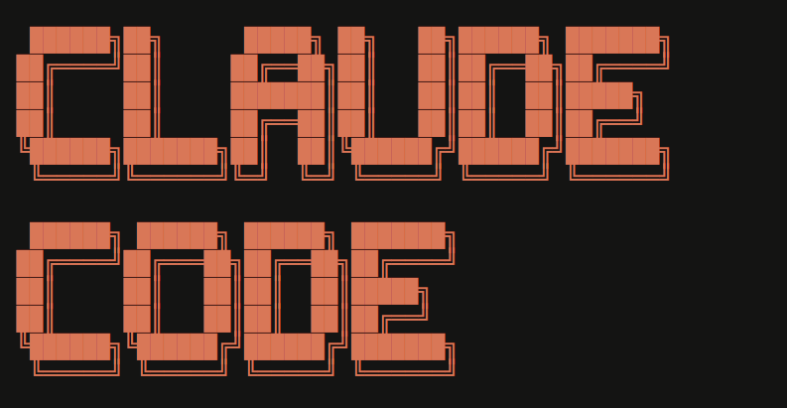
Claude Code
Claude code is an agentic AI coding tool that reads your codebase, edits files, runs commands, and autonomously works through problems.
Instead of responding to prompts one at a time, Claude can take on complex, multi-step tasks and execute them on your behalf.
© All rights reserved for Dr. Ryan Ahmed @Stemplicity Inc.

Slide 3
SLASH COMMANDS

Slide 4
Use Claude Built-in Slash Commands
A slash command is a shortcut that starts with / to quickly trigger an action in Claude Code.
It helps you work faster by giving structured instructions to Claude. Instead of typing a long request, the slash command immediately tells the AI what kind of operation you want.
Type / in Claude Code to see all available commands. These are built-in slash commands. The real power is creating your own commands.
/help See all available commands and skills
/usage Check your token usage and spending
/model Switch between AI models (faster vs smarter)
/compact Summarize conversation to free up context
© All rights reserved for Dr. Ryan Ahmed @Stemplicity Inc.
/diff Review all file changes Claude just made
/status Check your account, model, and connection
/skills List all installed skills
/init Create a CLAUDE.md project guide
/context shows Claude context window utilization

Slide 5
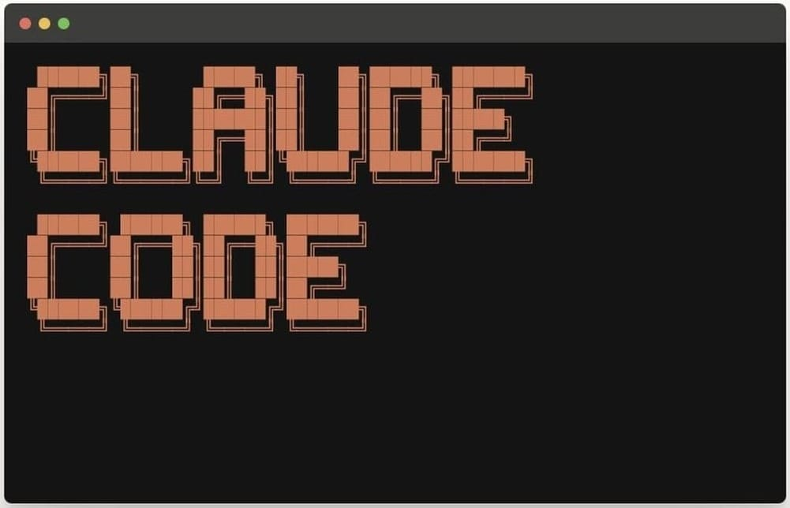
Slash Commands Demo in Claude Code
© All rights reserved for Dr. Ryan Ahmed @Stemplicity Inc.

Slide 6
PROJECT: BUILD A DASHBOARD WITH NO SKILLS (PART A)

Slide 7
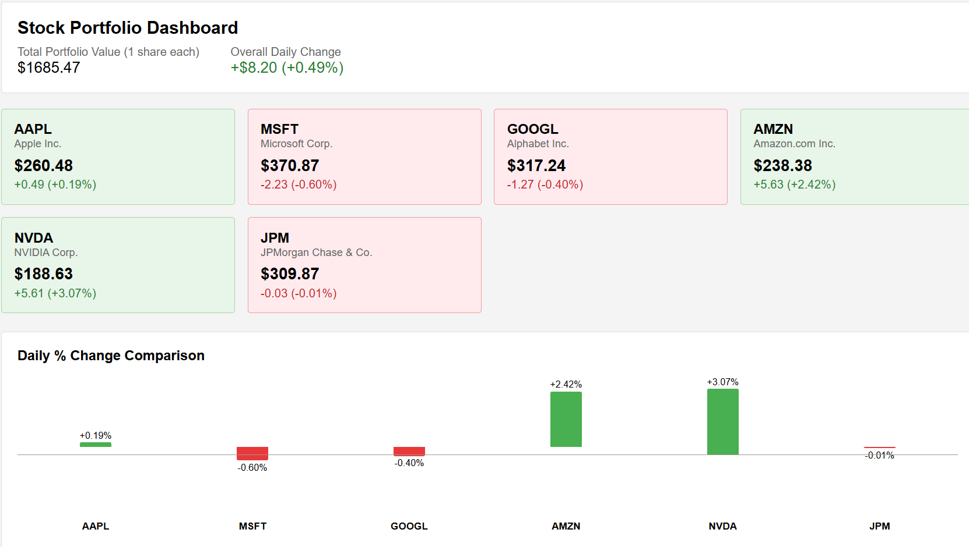
Project overview
Using Claude Code, we will build a single-page dashboard that reads stock financial data from Yahoo Finance and create a single HTML file.
A baseline build without any skills, so we can later compare the raw output against a skill-enhanced version to see how much design quality and polish the frontend-design skill adds.
© All rights reserved for Dr. Ryan Ahmed @Stemplicity Inc.

Slide 8
Project overview
1
2
3
Build Raw
One prompt → full dashboard
Install Skill
Add the frontend- design skill
Rebuild
Same prompt → stunning upgrade
© All rights reserved for Dr. Ryan Ahmed @Stemplicity Inc.

Slide 9
SKILLS

Slide 10
What is a skill?
A skill is a folder with a SKILL.md file; it gives Claude a detailed playbook and loads it automatically when the task is relevant.
How it loads
What's inside
Where it lives
Claude reads the SKILL.md at the start of a task; automatically or when you call it with a slash command like /frontend-design
Instructions, best practices, templates, and optional scripts that Claude follows to complete the task correctly every time
In .claude/skills/ for a project, or ~/.claude/skills/ for personal use across all projects.
© All rights reserved for Dr. Ryan Ahmed @Stemplicity Inc.

Slide 11
Anthropic’s Official Skills
Check the official skills list: https://github.com/anthropics/skills/tree/main/skills
pptx
PowerPoint
xlsx
Excel
docx
Word
Create and edit .pptx presentations
Build spreadsheets, charts, and formulas
Generate and edit formatted .docx documents
© All rights reserved for Dr. Ryan Ahmed @Stemplicity Inc.
pdf
PDF
frontend-design
Create, fill, merge, and extract from PDFs
Production-grade UI with bold aesthetic choices

Slide 12
Example: frontend-design skill
What it does
SKILL.md (simplified)
Loads before Claude writes any UI code
Gives Claude a design philosophy; bold aesthetic choices, distinctive fonts, purposeful color palettes
Prevents the generic 'AI-generated' look
Enforces production-grade output; not just functional, but visually refined
Auto-triggers when you ask to build any web UI, dashboard, or component
---
name: frontend-design
description: Create distinctive,
production-grade UI. Use when
building web components,
dashboards, or any web UI.
---
Before writing code, commit to
© All rights reserved for Dr. Ryan Ahmed @Stemplicity Inc.
a BOLD aesthetic direction:
- Pick a tone: minimal, luxury,
editorial, brutalist...
- Choose distinctive fonts
- Use purposeful color palettes
- Add meaningful animations
- Make it UNFORGETTABLE
Install: npx skills add anthropics/claude-code --skill frontend-design

Slide 13
PROJECT: INSTALL FRONT-END DESIGN SKILL (PART B)

Slide 14
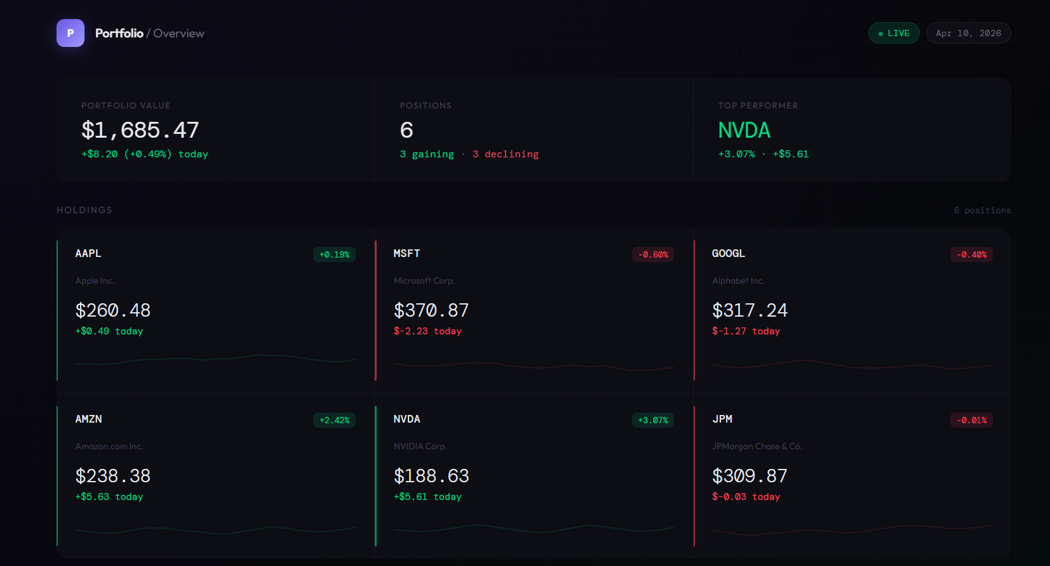
Project overview
Using Claude Code, we will build a single-page dashboard with the frontend design skill.
© All rights reserved for Dr. Ryan Ahmed @Stemplicity Inc.

Slide 15
Before and After Using Skills
Using the same prompt but with the frontend-design skill leads to a radically different result.
npx skills add anthropics/claude-code --skill frontend-design
Without Skill
Default fonts (Arial, system fonts)
Muted, safe color palette
Predictable card layouts
Minimal animations
It works... but looks generic
With frontend-design Skill
Bold, intentional typography pairings
Distinctive color palette with accents
Professional layout with visual hierarchy
Purposeful animations and micro-interactions
Looks like a designer built it
© All rights reserved for Dr. Ryan Ahmed @Stemplicity Inc.

Slide 16
PRACTICE OPPORTUNITY

Slide 17

Practice Opportunity
Build a landing page for a boutique pet grooming salon that includes:
A hero section with the name "Mindful Paws" and tagline "Where grooming meets calm“
An interactive booking quiz: Pet type (Dog/Cat/Other) → Size (Small/Medium/Large) → Service (Bath & Brush, Full Groom, Spa Day) → shows a price estimate
A services section with 4 services, each with a description and price
A gallery section with image placeholders of happy pets
A booking form with pet name, owner name, phone, and preferred date
The Challenge:
Build it raw: no skill, just one prompt. Save as `[business_name].html
Rebuild with skill: same prompt, frontend-design skill active. Save as `[business_name]_v2.html`
Compare: open both side by side. What changed? Write your own Claude Code prompt following the CIIO format (Context, Instruction, Input, Output).
© All rights reserved for Dr. Ryan Ahmed @Stemplicity Inc.

Slide 18
CONTEXT MANAGEMENT

Slide 19
Context Window
A context window is the total amount of text Claude can process in a single session, measured in tokens. Everything counts: your messages, Claude's replies, files it opened, and tool results.
When the session exceeds that limit, older content gets dropped, and Claude can no longer reference it.
System prompt
Anthropic
Anthropic's built-in rules
Tools
© All rights reserved for Dr. Ryan Ahmed @Stemplicity Inc.
Pre-installed
Built-in + extendable with MCP
Memory
Grows
Resources persisted across sessions, auto-grows as Claude learns your project
CLAUDE.md
← The one layer you control
You write
YOUR project instructions
Conversation history
Grows
Messages, code, tool output

Slide 20
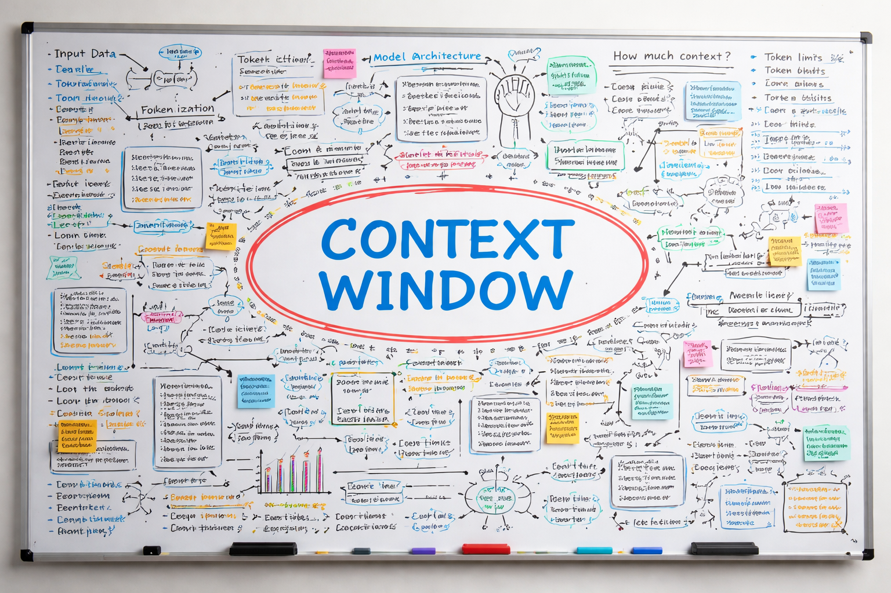
Context Window Analogy
The context window is like a whiteboard; Claude can only see what’s in it and nothing more. Every session, that whiteboard gets filled in layers. At the top are things Anthropic already wrote; Claude's built-in instructions & tools.
CLAUDE.md is the layer in your control. Every time Claude starts, it reads your file and knows your project. Below that is the conversation itself such as your messages, Claude's replies, any code it wrote, any files it opened. That part keeps growing the longer you work.
The context has a size limit. When it's full, Claude starts forgetting the top of the conversation. That's when you use /compact; it summarizes the history and frees up space, like erasing the old content while saving a summary.
© All rights reserved for Dr. Ryan Ahmed @Stemplicity Inc.

Slide 21
When the context Window fills up
The problem
The fix: /compact
Claude has a token limit
The longer you work, the more history fills up
When full, older messages get dropped
Claude loses early context; it may forget things you said
Run /compact in your session
Claude summarizes the conversation history
Summary replaces the full history which frees up space
CLAUDE.md always survives; it reloads fresh every time
© All rights reserved for Dr. Ryan Ahmed @Stemplicity Inc.
Key takeaway: CLAUDE.md is permanent. Conversation history is not.

Slide 22
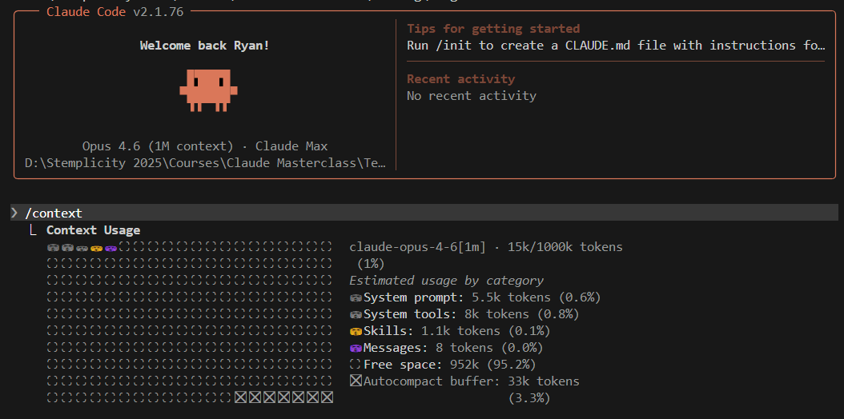
/context
Running /context in Claude Code shows a live breakdown of how your 1M token limit is being used, including the system prompt, tools, memory, and your conversation messages. At the start of a session, most of the window is still free (99% here).
The autocompact buffer (33k tokens, 3%) is space Claude reserves to summarize the conversation before the window fills up completely, so it can compact automatically without losing your work.
© All rights reserved for Dr. Ryan Ahmed @Stemplicity Inc.

Slide 23
Context Window in Claude
Show /context command
© All rights reserved for Dr. Ryan Ahmed @Stemplicity Inc.

Slide 24
CLAUDE.MD

Slide 25
CLAUDE.md
CLAUDE.md is a markdown file you add to your project root that Claude Code reads at the start of every session.
Claude thinks of it as a permanent briefing note; Claude shows up knowing your project without you repeating yourself every time.
CLAUDE.md
# AI Finance Agent — Project Context
## What This Is
A Python-based AI agent that analyzes financial statements and generate reports.
## Tech Stack
- Python 3.11, pandas, yfinance, matplotlib
- Anthropic Claude API (claude-sonnet-4-6) & Jupyter Notebooks for prototyping
## Key Commands
```bash
# Run the agent
python agent.py
# Run tests
pytest tests/ -v
# Install dependencies
pip install -r requirements.txt --break-system-packages
# Launch notebook
jupyter notebook notebooks/
```
## Project Structure
- /agent.py — Main agent entry point
- /tools/ — Financial analysis tools (ratio calc, etc.)
- /data/ — Sample 10-K filings (do not modify)
- /notebooks/ — Exploratory analysis (not production code)
- /tests/ — Unit tests
## Code Style
- Use type hints on all functions
- Docstrings required for every function
- Variable names should match finance terminology (e.g., `current_ratio`, not `cr`)
## Domain Terms
- **Liquidity Risk**: Risk that a firm can't meet short-term obligations
- **Current Ratio**: current_assets / current_liabilities
- **10-K**: Annual SEC filing — source of truth for financial data
## Workflow for New Features
1. Write a plan and confirm with user before coding
2. Write tests first (Test Driven Development (TDD))
3. Implement the feature
4. Run pytest and confirm passing
5. Update this CLAUDE.md if new patterns emerge
## Do Not Touch
- /data/raw/ — original source files, never modify
- .env — API keys, never log or print these
© All rights reserved for Dr. Ryan Ahmed @Stemplicity Inc.

Slide 26
CLAUDE.md Best Practices
Think of CLAUDE.md as AI onboarding, not a wiki. High signal, short, and stable.
DO
DON'T
Keep it under 200 lines
Include your key commands (run, test)
Add domain-specific terms your project uses
Define your preferred workflow steps
Update CLAUDE.md when new patterns emerge
Dump everything you know about the project
Write instructions that only apply sometimes
Let it grow into a long document
Repeat what Claude can already infer from the code
Use it as a running checklist or task tracker
© All rights reserved for Dr. Ryan Ahmed @Stemplicity Inc.

Slide 27
MCP

Slide 28

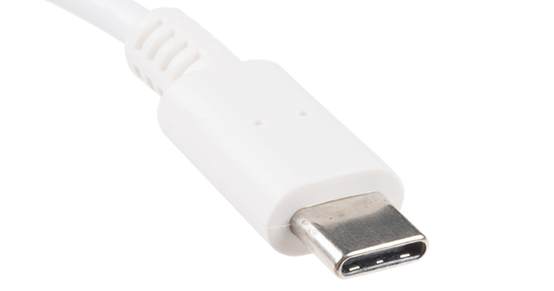

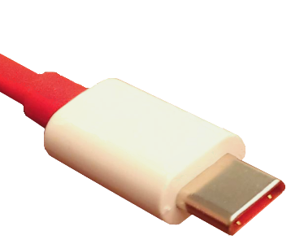





Model Context Protocol (MCP)?
MCP is an open standard and open-source framework introduced by Anthropic to standardize how AI models interact with external tools, systems, and data sources.
Problem (Without MCP)
Solution (With MCP)
© All rights reserved for Dr. Ryan Ahmed @Stemplicity Inc.
MCP
AI Agent
AI Agent
MCP
MCP
Custom APIs
Standardized APIs

Slide 29
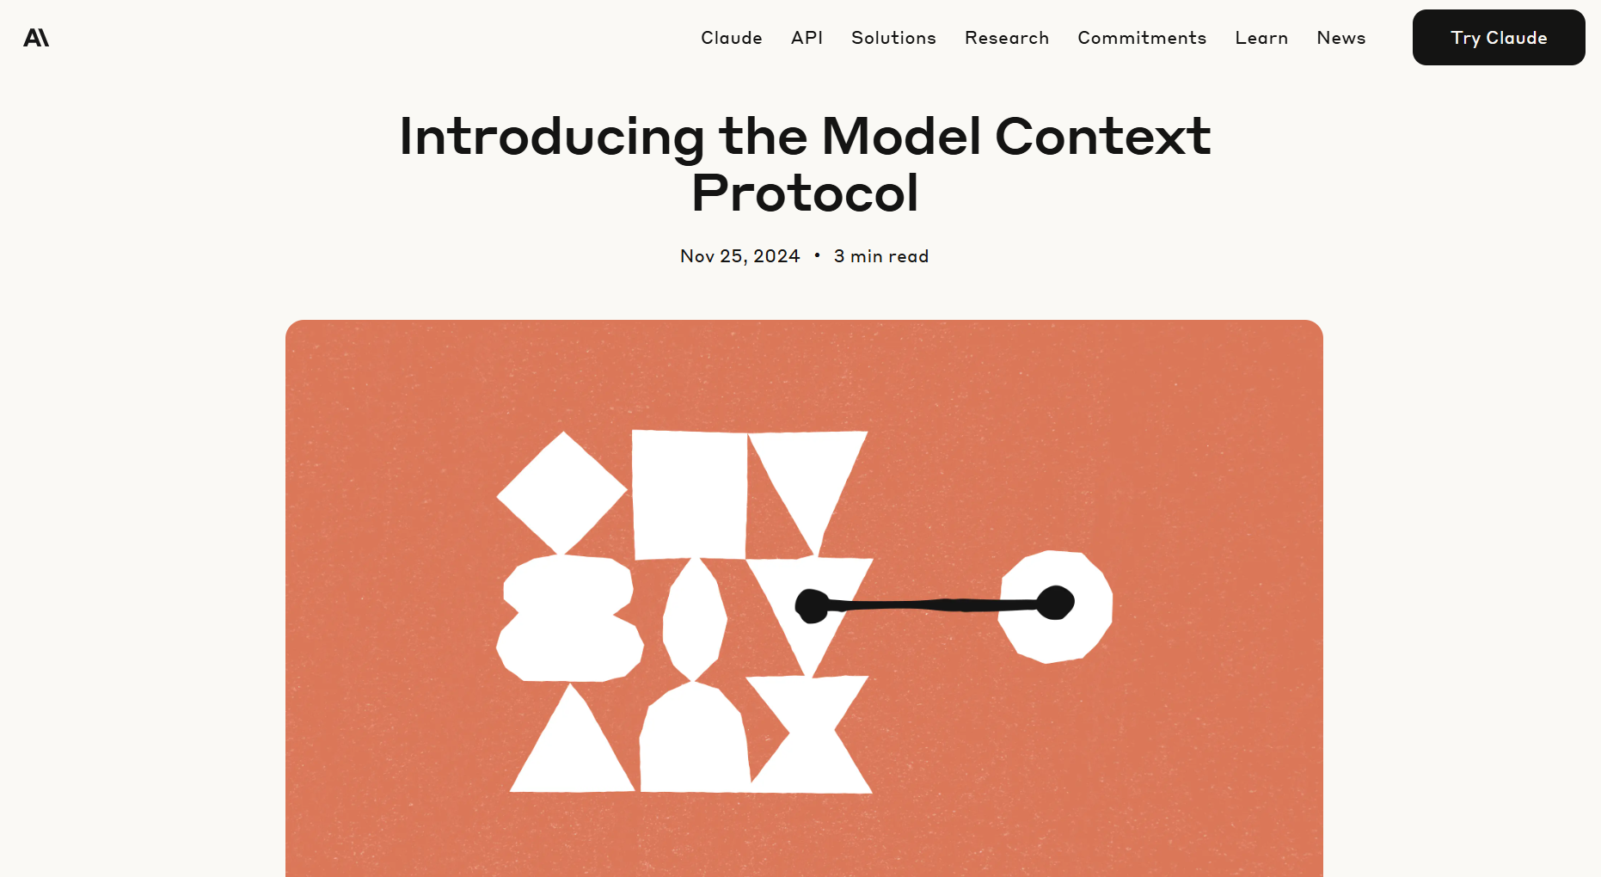
MCP Connectors
Connectors let Claude pull from external systems; e.g., analyze a Google Sheet, then move a chart directly into a PowerPoint deck.
Available Connectors
Google Drive
Google Calendar
Gmail
Slack
DocuSign
Salesforce
FactSet
WordPress
© All rights reserved for Dr. Ryan Ahmed @Stemplicity Inc.
Apollo
Clay
Outreach
SimilarWeb
https://www.anthropic.com/news/model-context-protocol

Slide 30
Thank you!

